Slide 1
Launch application by analyzing uploaded file
Group member: Zhuqixing Qiuying Xunwenjing
Date: 2020.07.31

Slide 2
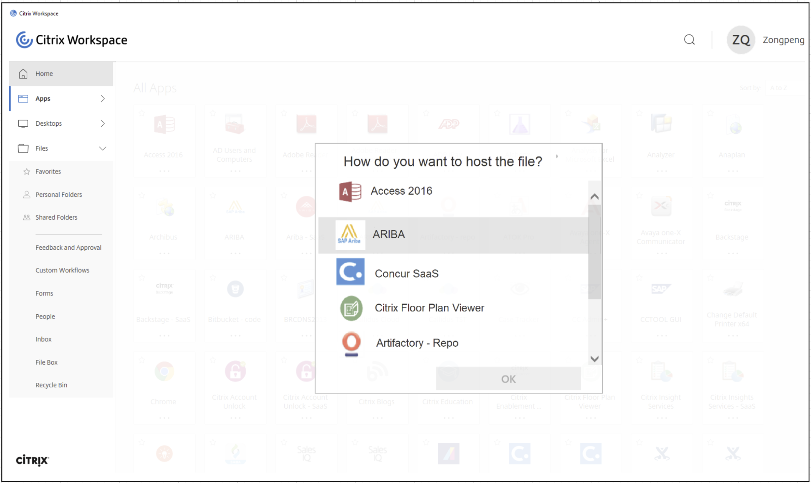
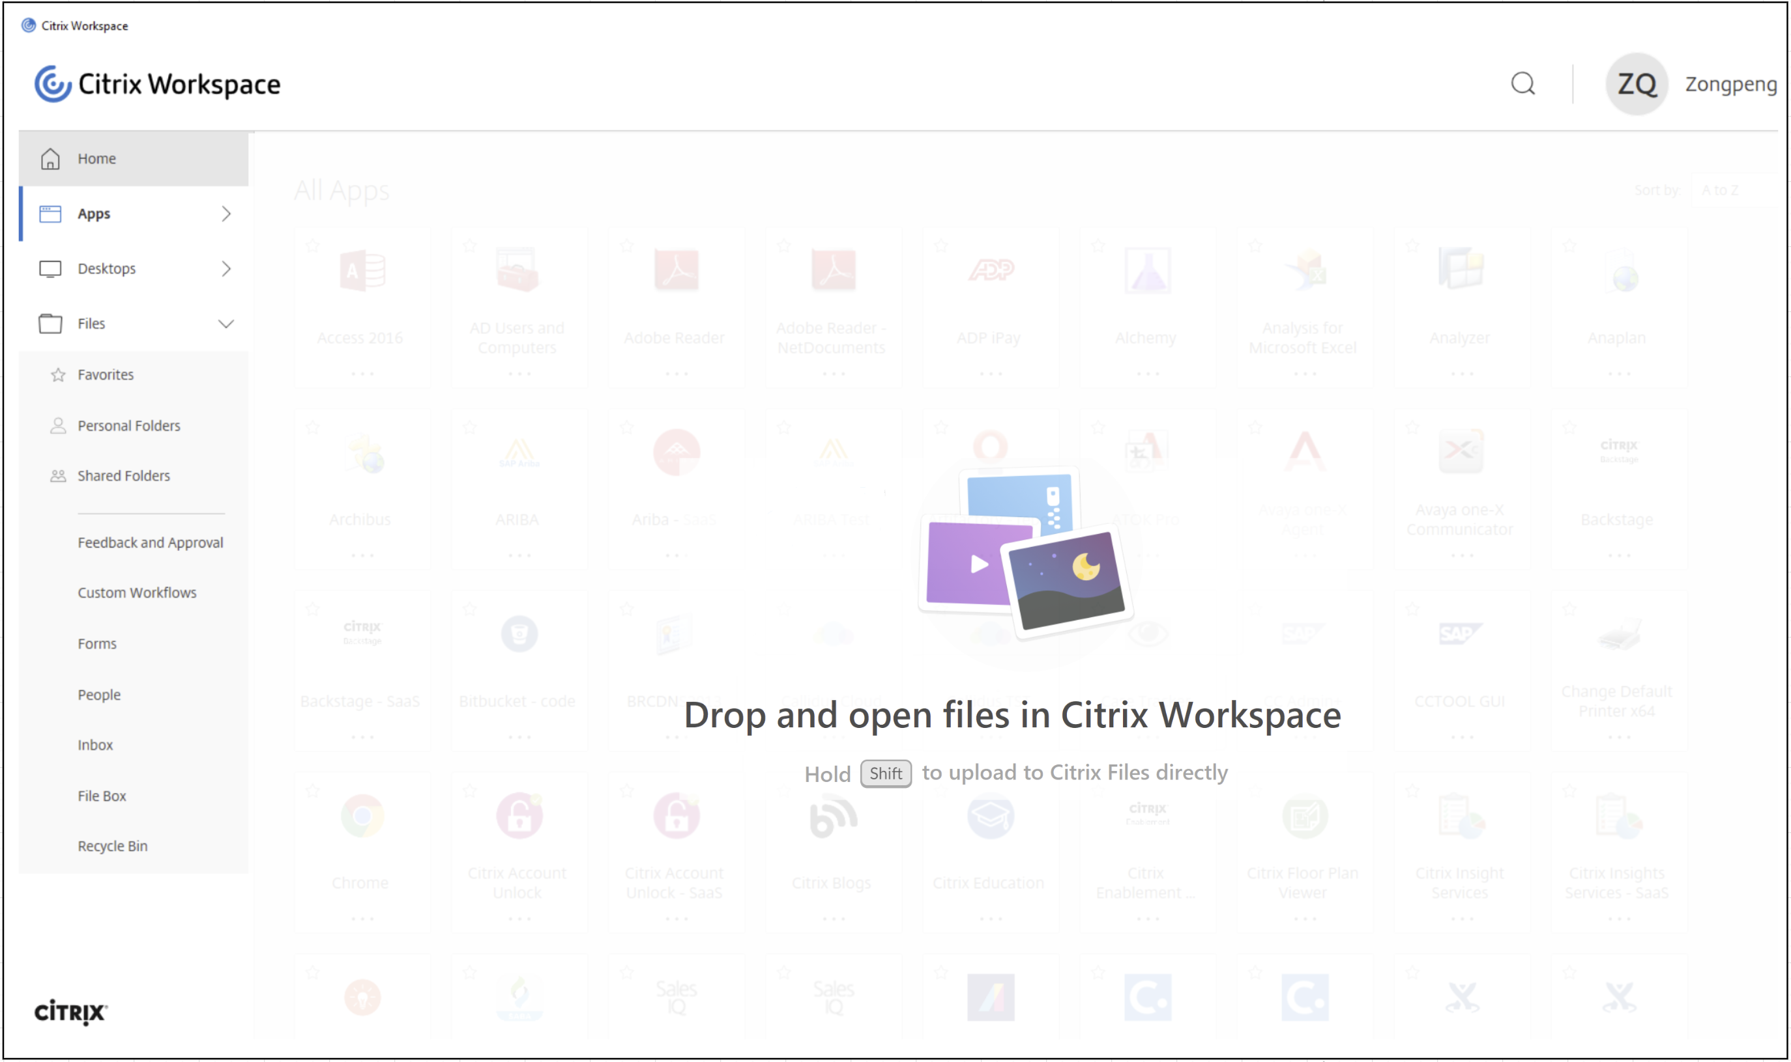
What we want to do

Slide 3
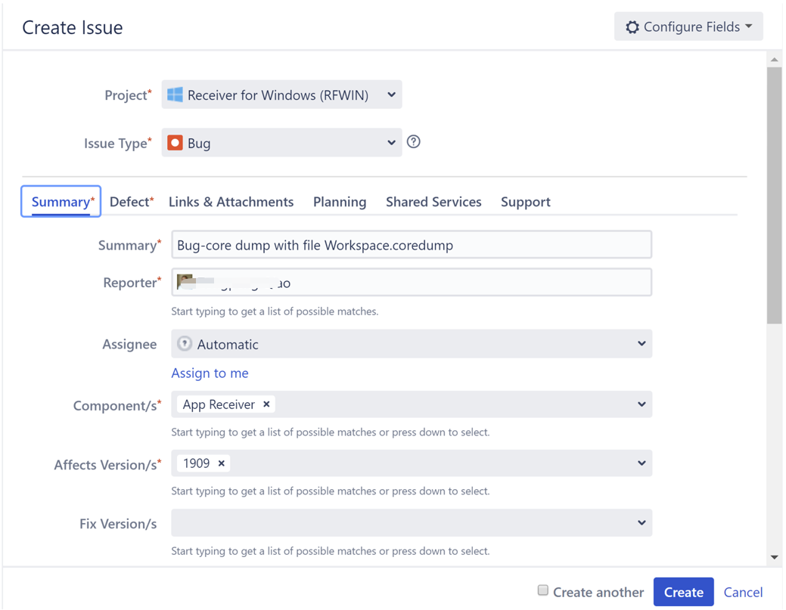
What we want to do

Slide 4
Milestones (adjusted based on background)
Set up basic framework(by 30/7)
Create a web page with react
Support uploading functionality & store in chrome storage
Basic text analysis
Fill content into webpage
Basic CICD framework ready
SPIKE & enhancement(by 30/8)
SPIKE to on OCR for images
Map content with SaaS app
Leverage Selenium to fill content into a new page
CICD optimization

Slide 5
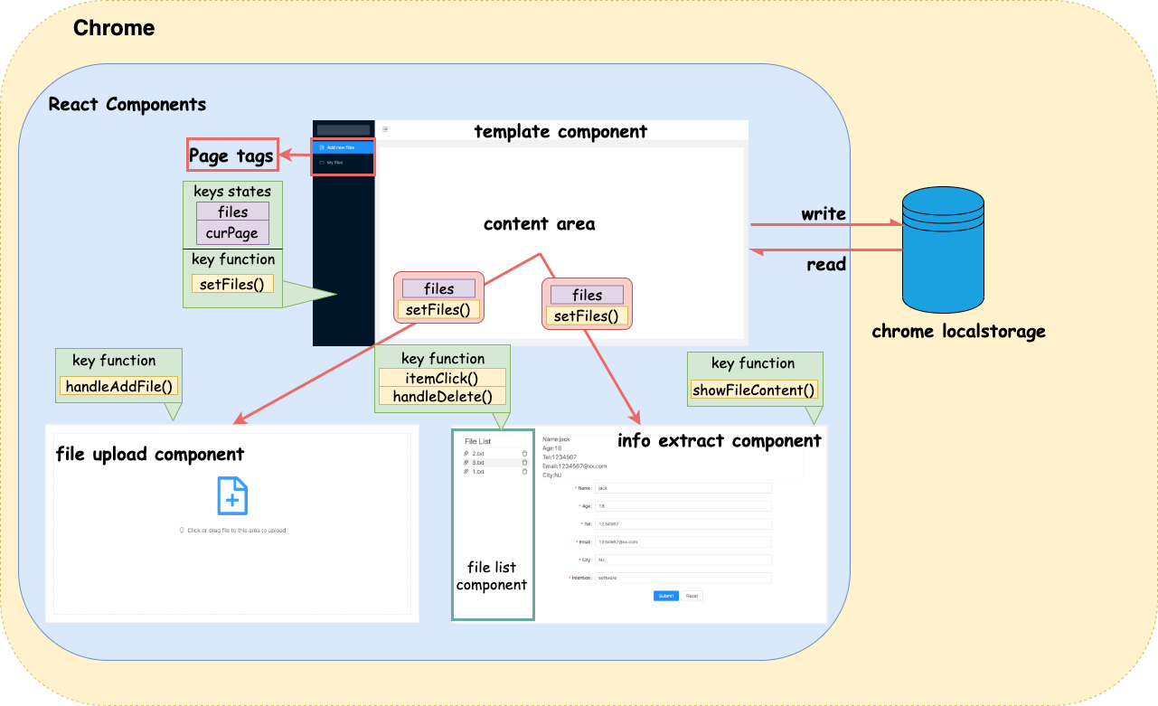
HLD

Slide 6
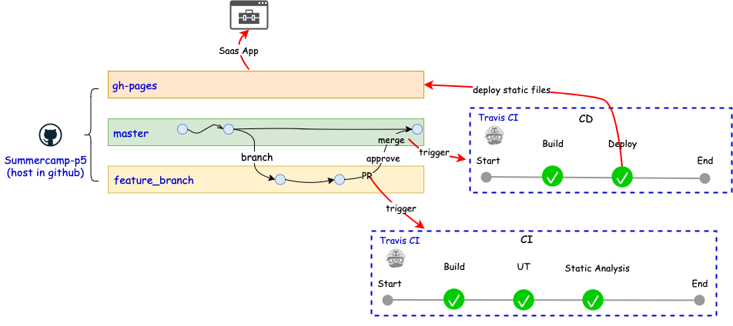
CICD

